Slide 1
Numerical Procedures
Chapter 20

Slide 2
Binomial Trees
Binomial trees are frequently used to approximate the movements in the price of a stock or other asset
In each small interval of time the stock price is assumed to move up by a proportional amount u or to move down by a proportional amount d

Slide 3
Movements in Time δt
(Figure 19.1)
p
Su
S
1 – p
Sd

Slide 4
1. Tree Parameters for a
Nondividend Paying Stock
We choose the tree parameters p, u, and d so that the tree gives correct values for the mean & standard deviation of the stock price changes in a risk-neutral world
e^{r δt} = pu + (1– p )d
σ²δt = pu ² + (1– p )d ² – [pu + (1– p )d ]²
A further condition often imposed is u = 1/ d

Slide 5
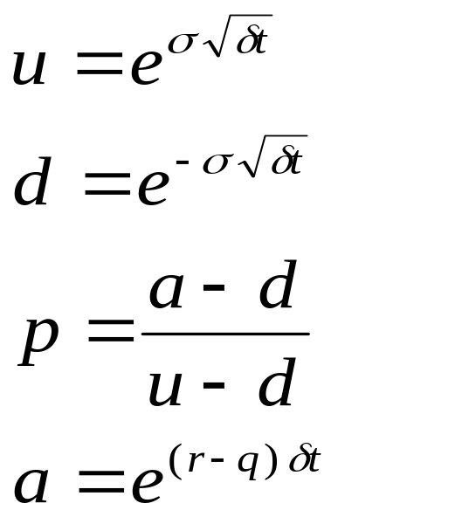
2. Tree Parameters for a
Nondividend Paying Stock
(Equations 19.4 to 19.7)
When δt is small, a solution to the equations is

Slide 6
The Complete Tree
(Figure 19.2)
S₀u⁴
S₀u³
S₀u²
S₀u²
S₀u
S₀u
S₀
S₀
S₀
S₀d
S₀d
S₀d²
S₀d²
S₀d³
S₀d⁴
Notes:
Bild tree and estimate delta.. More steps could help

Slide 7
Backwards Induction
We know the value of the option at the final nodes
We work back through the tree using risk-neutral valuation to calculate the value of the option at each node, testing for early exercise when appropriate

Slide 8
Example: Put Option
  S₀ = 50; K = 50; r =10%; σ = 40%;
T = 5 months = 0.4167;
δt = 1 month = 0.0833
The parameters imply
u = 1.1224; d = 0.8909;
a = 1.0084; p = 0.5076

Slide 9
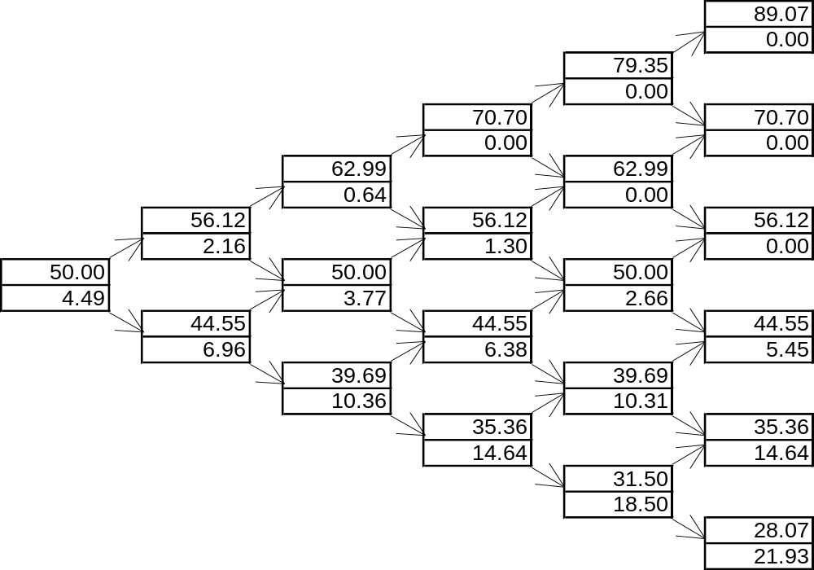
Example (continued)
Figure 19.3

Slide 10
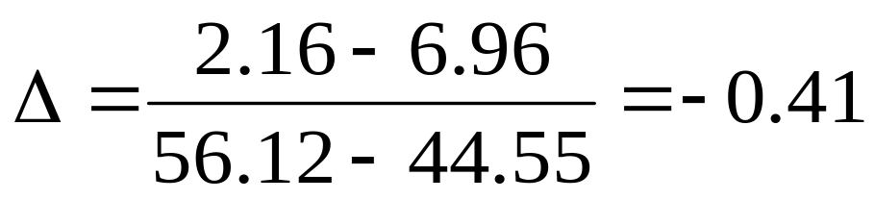
Calculation of Delta
Delta is calculated from the nodes at time δt

Slide 11
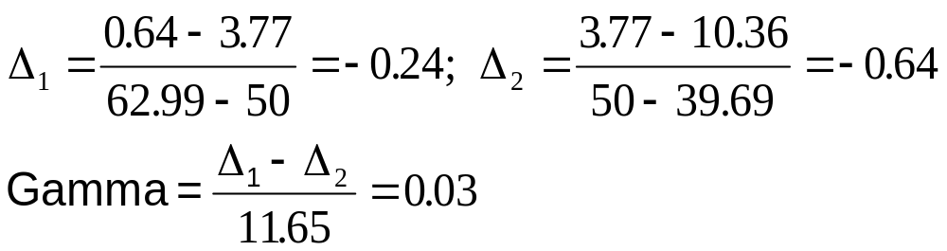
Calculation of Gamma
Gamma is calculated from the nodes at time 2δt
Notes:
Trade calculate all the possible Gamma att calculate. Then average.
Speed and accuracy

Slide 12
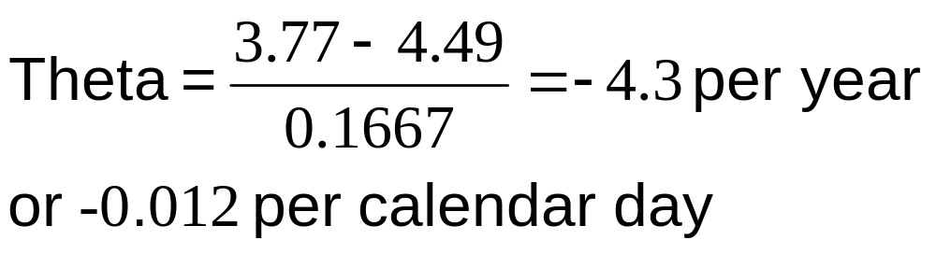
Calculation of Theta
Theta is calculated from the central nodes at times 0 and 2δt

Slide 13
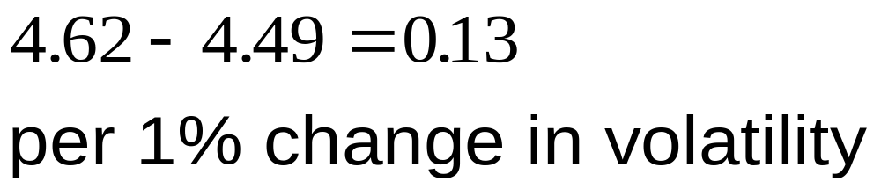
Calculation of Vega
We can proceed as follows
Construct a new tree with a volatility of 41% instead of 40%.
Value of option is 4.62
Vega is

Slide 14
Trees and Dividend Yields
When a stock price pays continuous dividends at rate q we construct the tree in the same way but set a = e^{(r – q )δt}
As with Black-Scholes:
  For options on stock indices, q equals the dividend yield on the index
  For options on a foreign currency, q equals the foreign risk-free rate
  For options on futures contracts q = r

Slide 15
Binomial Tree for Dividend Paying Stock
Procedure:
  Draw the tree for the stock price less the present value of the dividends
  Create a new tree by adding the present value of the dividends at each node
This ensures that the tree recombines and makes assumptions similar to those when the Black-Scholes model is used

Slide 16
Extensions of Tree Approach
Time dependent interest rates
The control variate technique

Slide 17
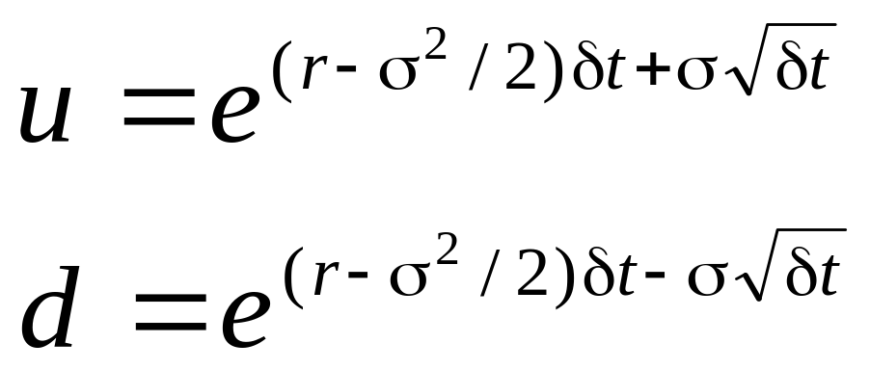
Alternative Binomial Tree
Instead of setting u = 1/d we can set each of the 2 probabilities to 0.5 and

Slide 18
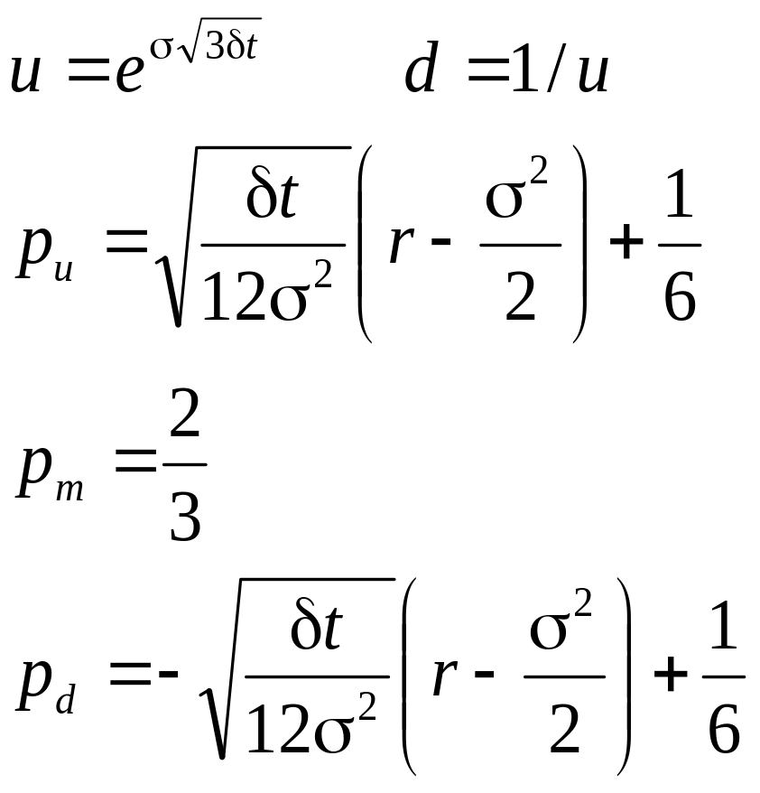
Trinomial Tree (Page 424)
Su
p_{u}
p_{m}
S
S
p_{d}
Sd

Slide 19
Adaptive Mesh Model
This is a way of grafting a high resolution tree on to a low resolution tree
We need high resolution in the region of the tree close to the strike price and option maturity

Slide 20
Monte Carlo Simulation
When used to value European stock options, this involves the following steps:
1. Simulate 1 path for the stock price in a risk neutral world
2. Calculate the payoff from the stock option
3. Repeat steps 1 and 2 many times to get many sample payoff
4. Calculate mean payoff
5. Discount mean payoff at risk free rate to get an estimate of the value of the option

Slide 21
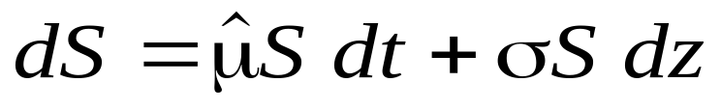
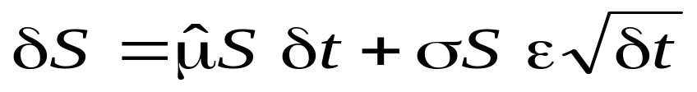
Sampling Stock Price Movements
(Equations 19.13 and 19.14, page 427)
In a risk neutral world the process for a stock price is
We can simulate a path by choosing time steps of length δt and using the discrete version of this
where ε is a random sample from φ(0,1)

Slide 22
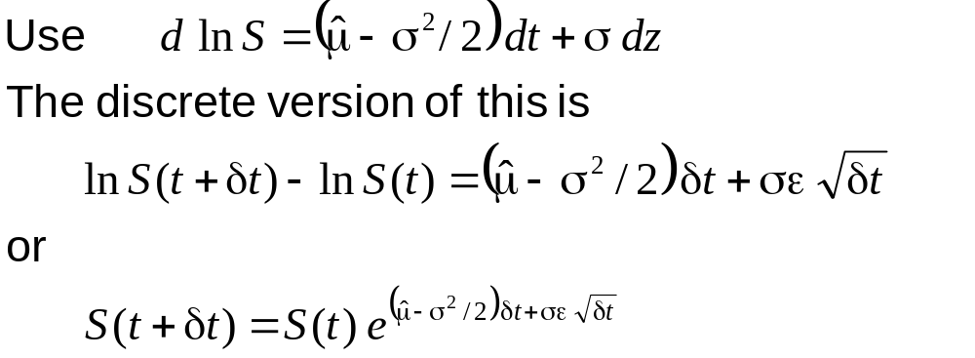
A More Accurate Approach
(Equation 19.15, page 428)

Slide 23
Extensions
When a derivative depends on several underlying variables we can simulate paths for each of them in a risk-neutral world to calculate the values for the derivative

Slide 24
Sampling from Normal Distribution (Page 430)
One simple way to obtain a sample
from φ(0,1) is to generate 12 random numbers between 0.0 & 1.0, take the sum, and subtract 6.0

Slide 25
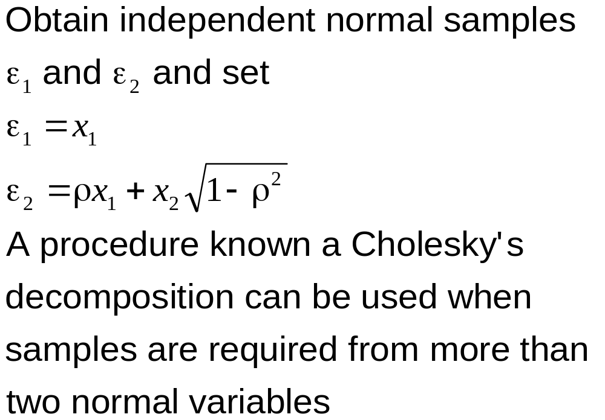
To Obtain 2 Correlated Normal Samples

Slide 26
Standard Errors in Monte Carlo Simulation
The standard error of the estimate of the option price is the standard deviation of the discounted payoffs given by the simulation trials divided by the square root of the number of observations.

Slide 27
Application of Monte Carlo Simulation
Monte Carlo simulation can deal with path dependent options, options dependent on several underlying state variables, and options with complex payoffs
It cannot easily deal with American-style options

Slide 28
Determining Greek Letters
For Δ:
1. Make a small change to asset price
2. Carry out the simulation again using the same random number streams
3. Estimate Δ as the change in the option price divided by the change in the asset price
Proceed in a similar manner for other Greek letters

Slide 29
Variance Reduction Techniques
Antithetic variable technique
Control variate technique
Importance sampling
Stratified sampling
Moment matching
Using quasi-random sequences

Slide 30
Representative Sampling Through the Tree
We can sample paths randomly through a binomial or trinomial tree to value an option
An alternative is to choose representative paths
Paths are representative if the proportion of paths through each node is approximately equal to the probability of the node being reached

Slide 31
Finite Difference Methods
Finite difference methods aim to represent the differential equation in the form of a difference equation
Define ƒ_{i,j} as the value of ƒ at time iδt when the stock price is jδS

Slide 32
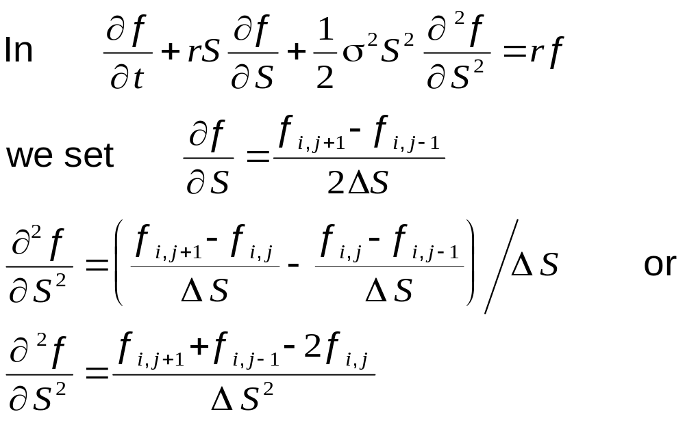
Finite Difference Methods
(continued)

Slide 33
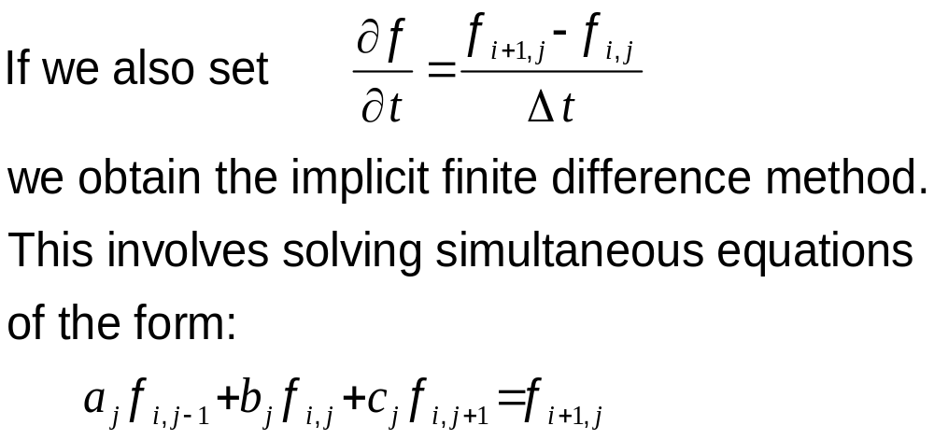
Implicit Finite Difference Method (Equation 19.25, page 437)

Slide 34
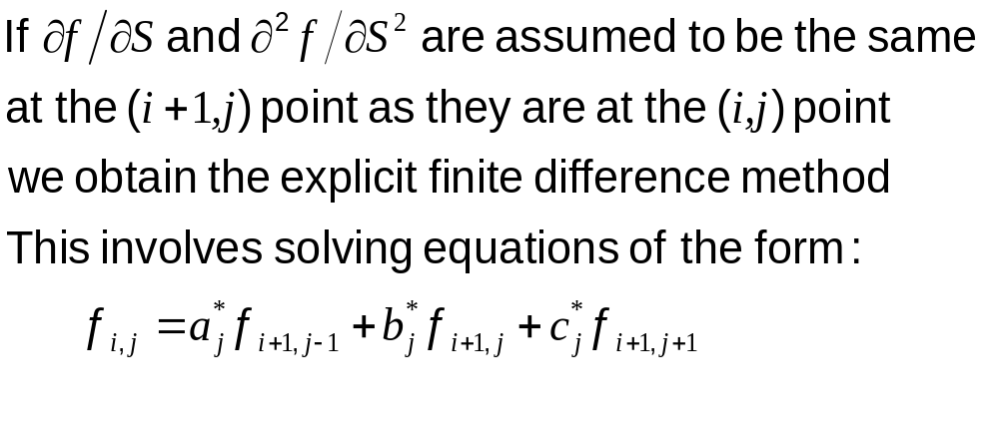
Explicit Finite Difference Method (Equation 19.34, page 440)
Notes:
You can caluate the know values of the amerikan option at three boundries fnj = max (0, K- jsigmaS)

Slide 35
Implicit vs Explicit Finite Difference Method
The explicit finite difference method is equivalent to the trinomial tree approach
The implicit finite difference method is equivalent to a multinomial tree approach

Slide 36
Implicit vs Explicit
Finite Difference Methods
(Figure 19.16, page 441)
ƒ_{i , j +1}
ƒ_{i +1, j +1}
ƒ_{i , j}
ƒ_{i +1, j}
ƒ_{i , j}
ƒ_{i +1, j}
ƒ_{i , j –1}
ƒ_{i +1, j –1}
Implicit Method
Explicit Method

Slide 37
Other Points on Finite Difference Methods
It is better to have ln S rather than S as the underlying variable
Improvements over the basic implicit and explicit methods:
  Hopscotch method
  Crank-Nicolson method

Slide 38
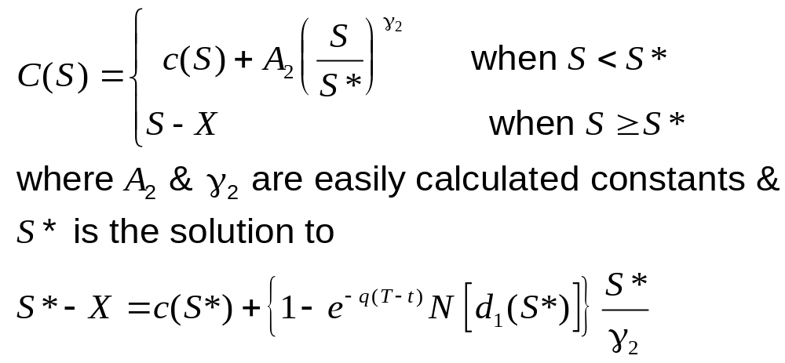
The Barone Adesi & Whaley Analytic Approximation for American Call Options

Slide 39
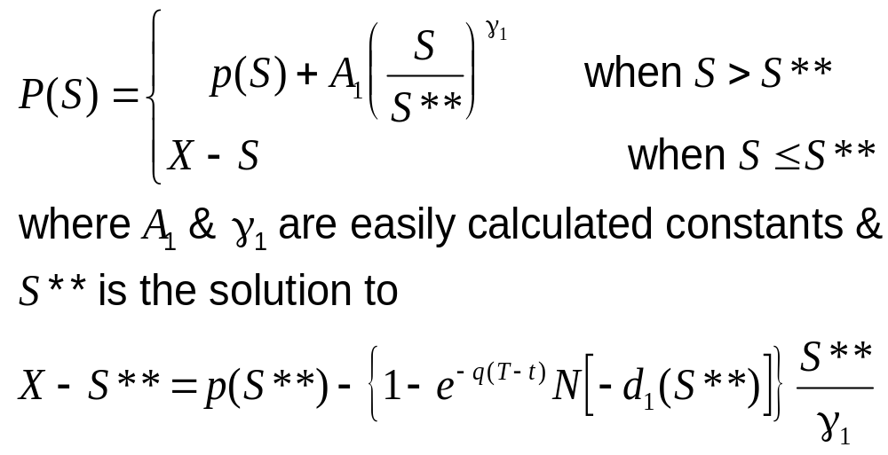
The Barone Adesi & Whaley Analytic
Approximation for American Put Options

